Slide 1
Covid-19與Twitter
劉紹楷 江郁欣 謝宜呈 陳祈欣

Slide 2
目錄
CONTENTS
01
研究動機
03
分析成果
02
研究步驟
04
心得與困難

Slide 3
01
研究動機
1

Slide 4
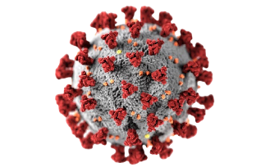

研究動機
我們想探討人民對於現在討論度較高的covid-19議題之看法。先運用爬蟲方式抓取twitter平台之留言，再利用數位人文研究平台進行分析，找出受covid-19影響之高曝光率國家名以及相關身體部位名，並且探討其背景之原因。
2

Slide 5
02
研究步驟
3

Slide 6
研究步驟
01
Twitter爬蟲
建立權威檔
03
分析
結果視覺化
Option 03
Option 04
02
尋找相關新聞
04
心得與困難
Option 01
Option 02
4

Slide 7
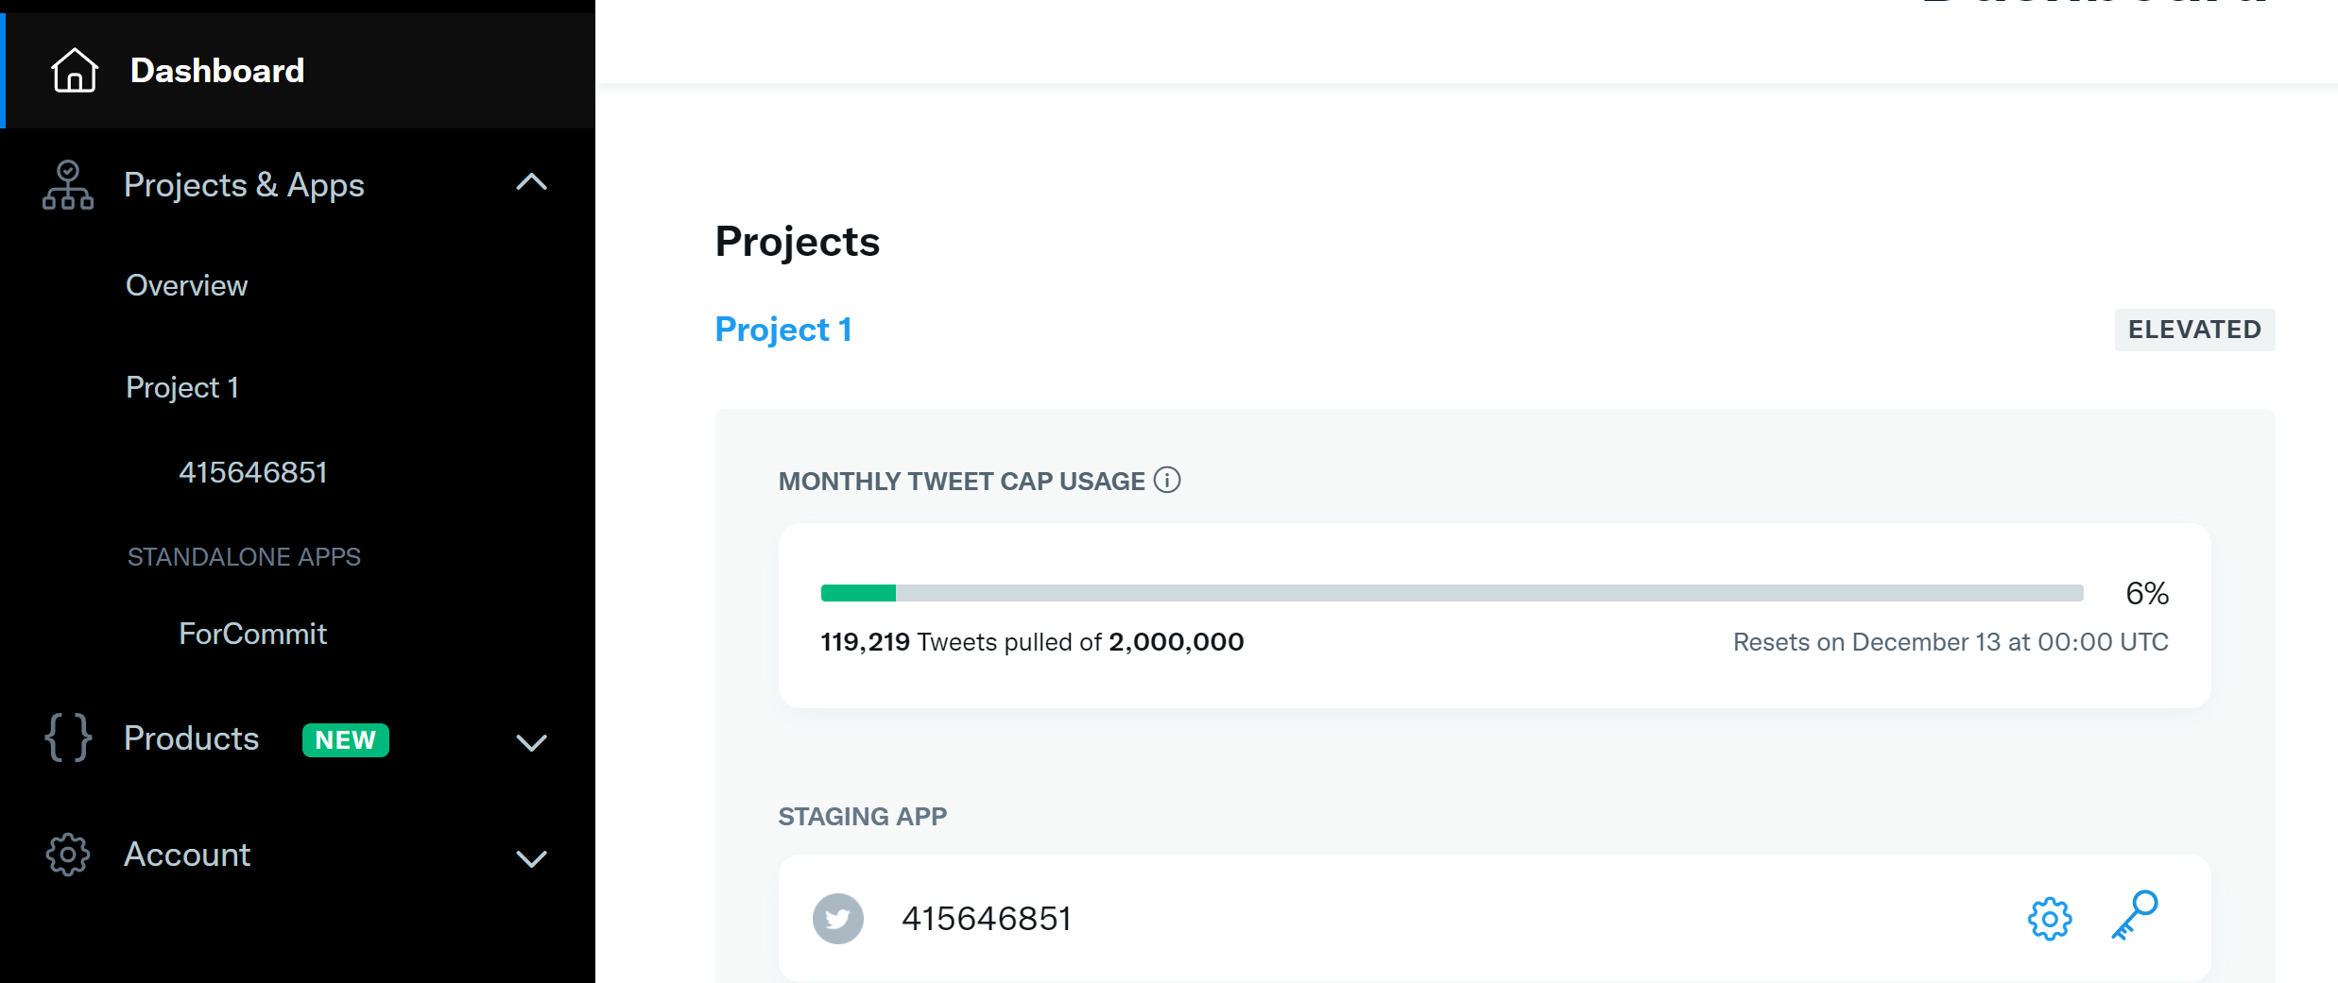
Twitter API & Tweepy
We have many PowerPoint templates that has been specifically designed to help anyone that is stepping into the world of PowerPoint for the very first time.
We have many PowerPoint templates that has been specifically designed to help anyone that is stepping into the world of PowerPoint for the very first time.
We have many PowerPoint templates that has been specifically designed to help anyone that is stepping into the world of PowerPoint for the very first time.
We have many PowerPoint templates that has been specifically designed to help anyone that is stepping into the world of PowerPoint for the very first time.
We have many PowerPoint templates that has been specifically designed to help anyone that is stepping into the world of PowerPoint for the very first time.
We have many PowerPoint templates that has been specifically designed to help anyone that is stepping into the world of PowerPoint for the very first time.
We have many PowerPoint templates that has been specifically designed to help anyone that is stepping into the world of PowerPoint for the very first time.
We have many PowerPoint templates that has been specifically designed to help anyone that is stepping into the world of PowerPoint for the very first time.
5

Slide 8
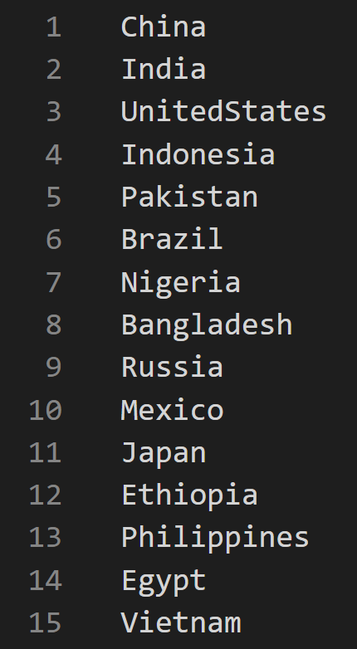
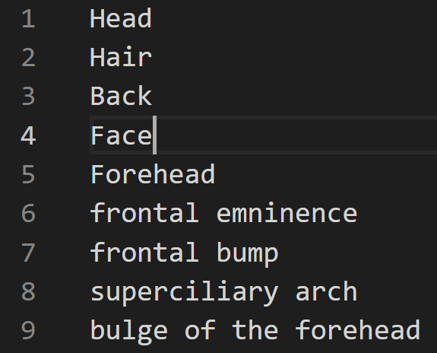
權威檔
器官權威檔
國家權威檔
6

Slide 9
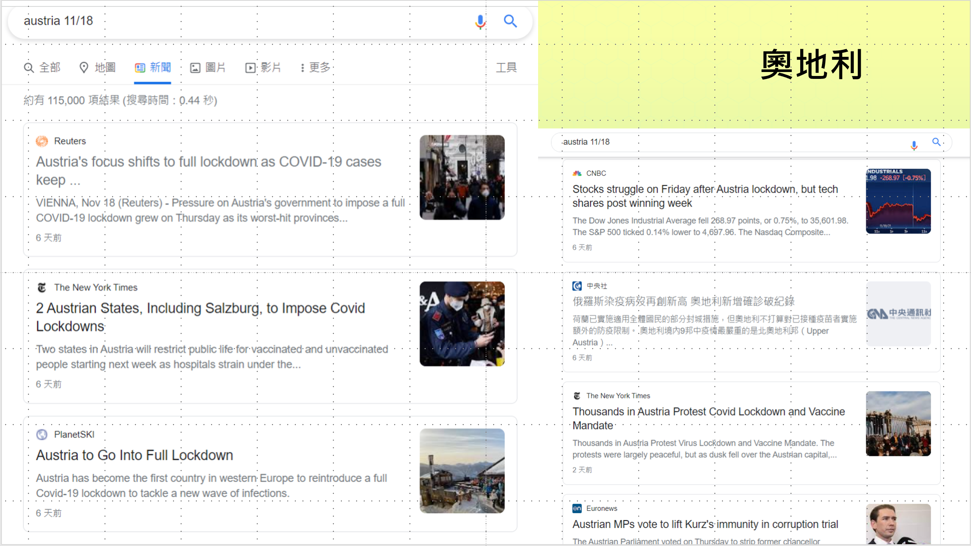
新聞
Austria back in lockdown
Lisa確診
Taiwan reports 5 imported COVID cases
打COVID追加劑 法國防疫顧問
……
7

Slide 10
新聞
Austria back in lockdown
Lisa確診
Taiwan reports 5 imported COVID cases
打COVID追加劑 法國防疫顧問
……
8

Slide 11
03
分析成果
9

Slide 12
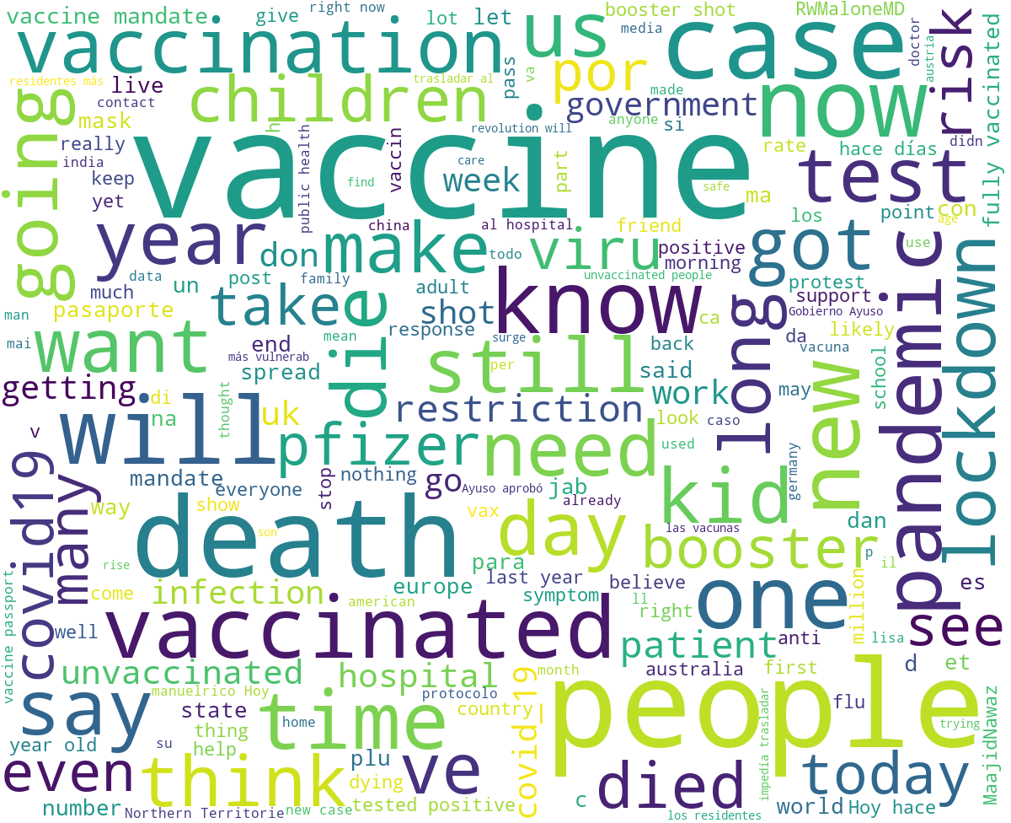
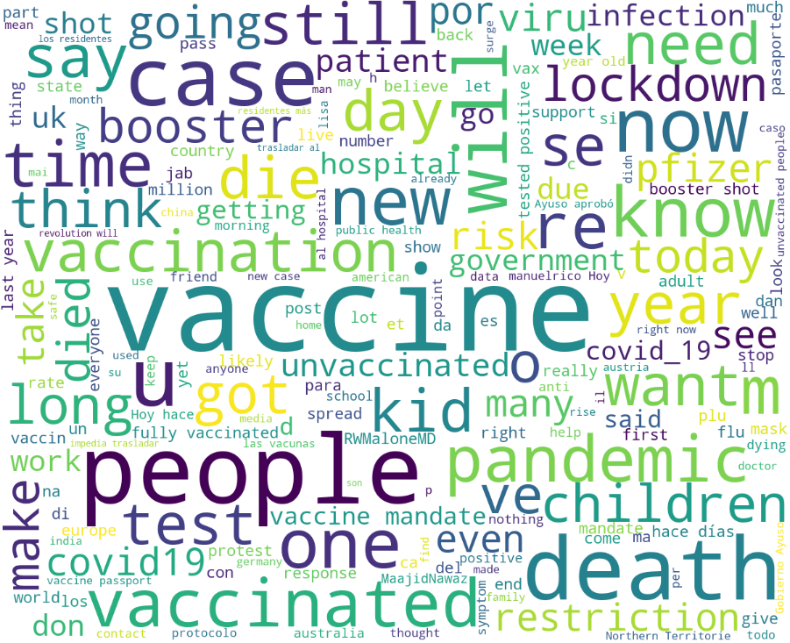
文字雲
利用爬蟲方式分析twitter留言中重複較高的字詞。資料抓取時間: 11/18~11/23
10

Slide 13
熱門字-時間排列
11/23：
BlackPink的成員Lisa
確診covid-19
11

Slide 14
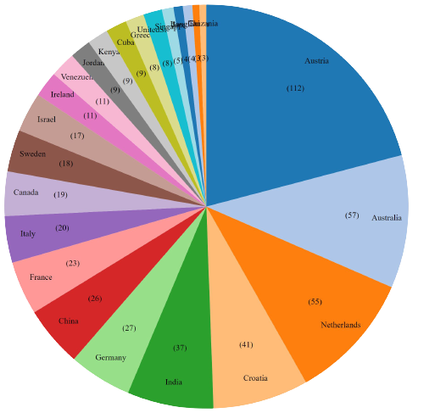
國家
奧地利
利用數位人文研究平台
，從twitter留言中分析出受疫情影響且討論度較高的國家。
澳洲
克羅埃西亞
荷蘭
12

Slide 15
國家-時間排列
13

Slide 16
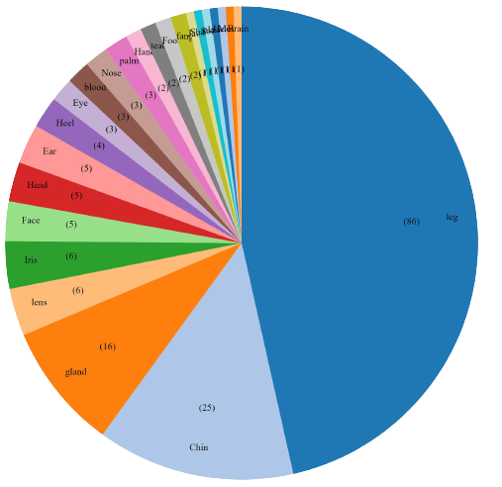
肺炎影響身體部位
腳
利用數位人文研究平台，從twitter留言中分析出受疫情影響且討論度較高的身體部位名。
下巴
14

Slide 17
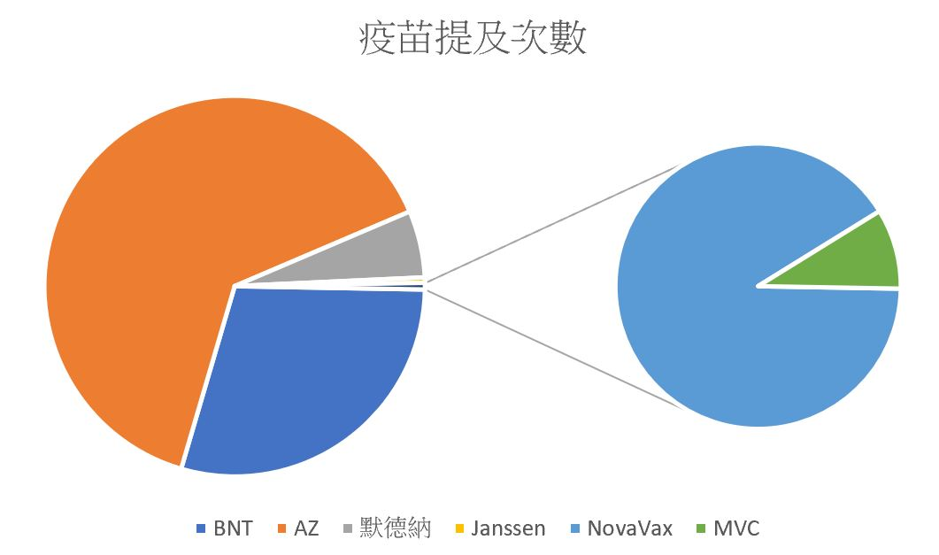
疫苗
利用程式和EXCEL，從twitter留言中分析出各類疫苗提及次數
15

Slide 18
04
困難
16

Slide 19
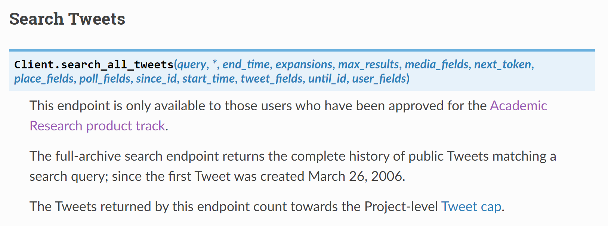
困難
Twitter API 搜尋所有資料必須申請學術專用API，
一般API只能搜尋近7天的資料。
17

Slide 20
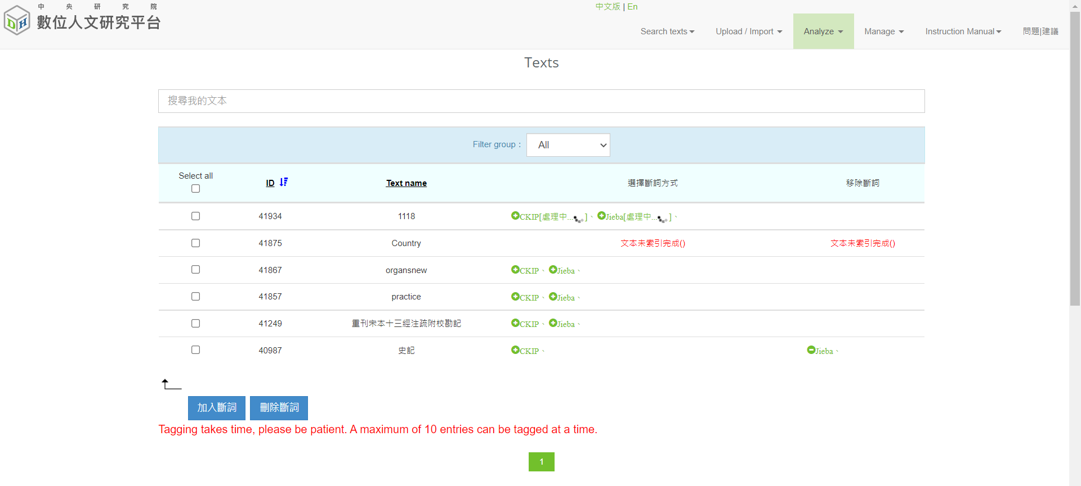
困難
利用數位人文研究平台操作英文斷詞系統時較困難，可能需要找尋別的分析方式。
18

Slide 21
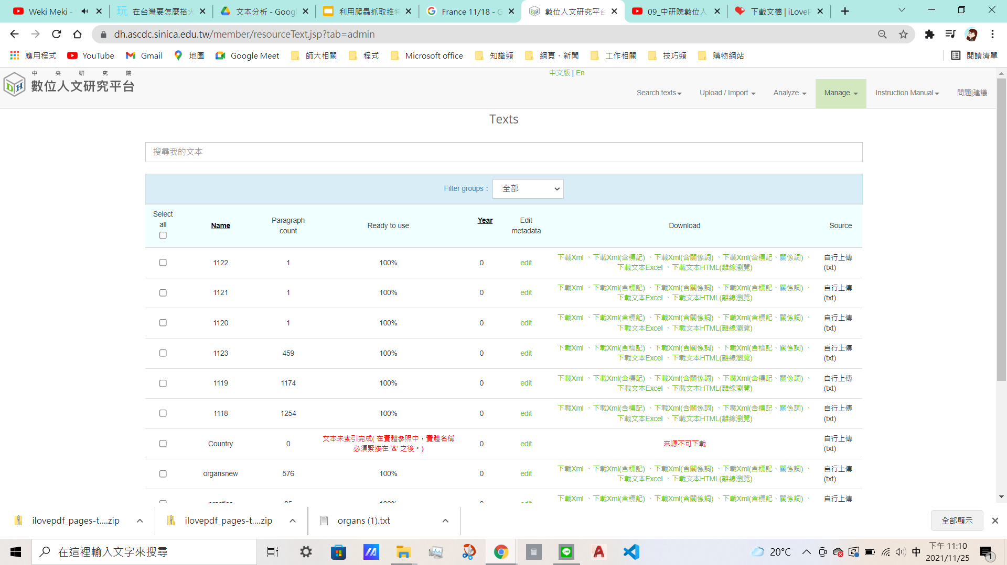
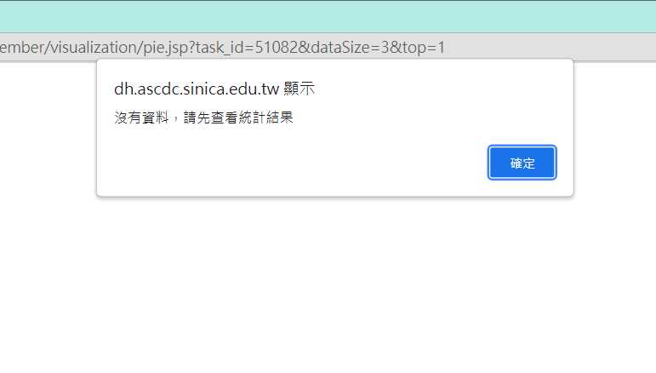
困難
有些文本上傳的時候顯示沒有資料，不知道出了什麼問題....
19

Slide 22
04
心得
20

Slide 23
心得
能嘗試運用數位人文分析平台分析爬蟲出來的資料，讓我們覺得很新鮮，也希望可以更熟悉此平台的操作，未來能運用在不同的課程上。
19

Slide 24
分工表
爬蟲：劉紹楷
製作權威檔：謝宜呈
利用數位人文平台分析：劉紹楷、謝宜呈、江郁欣、陳祈欣
尋找新聞：陳祈欣
探討成因：江郁欣
PPT製作：劉紹楷、陳祈欣
20

Slide 25
THANKS
THANK YOU FOR WATCHING

